Slide 1

School of Computing Science & Engineering
Course Code: MCAN1140 Course Name: Database Management System
Program: MCA
Course Code: MCAN1140
Course: Database Management System
Faculty Name: Dr. Raju Ranjan Program Name: MCA

Slide 2
School of Computing Science & Engineering
Vision
To be known globally as a premier department of Computer Science and Engineering for value-based education, multidisciplinary research and innovation.
Mission
M1: Developing a strong foundation in fundamentals of computing science with responsiveness towards emerging technologies.
M2: Establishing state-of-the-art facilities and adopt education 4.0 practices to analyze, develop, test and deploy sustainable ethical IT solutions by involving multiple stakeholders.
M3: Establishing Centers of Excellence for multidisciplinary collaborative research in association with industry and academia.
Program Name: MCA
Program Name: M.Sc. Program Code: MSCS1120

Slide 3
School of Computing Science & Engineering
Course Outcomes (COs)
CO Number | Title
CO1 | Understand the basic concepts, modeling techniques and architecture of DBMS (K2).
CO2 | Apply the concept of ER Model and SQL programming using DDL and DML commands (K3).
CO3 | Able to store and analyze data into normalized format. (K4).
CO4 | Examine the basic concept of transaction processing, recovery and concurrency control techniques in database (K4)
CO5 | Understand the basics characteristics, advantages, disadvantages of Object-Oriented Databases, Object-relational Database, Distributed databases (K4).
CO6 | Develop understanding on business applications of Database Management Systems to conduct research and improve the performance of commercial database systems and applications(K2).
Program Name: MCA

Slide 4
School of Computing Science & Engineering
Program Outcomes (POs)
PO Number | Title
PO1 | Computing Science Knowledge: Apply the knowledge of mathematics, statistics, computing science and information science fundamentals to the solution of complex computer application problems.
PO2 | Problem Analysis: Identify, formulate, review research literature, and analyze complex computing science problems reaching substantiated conclusions using first principles of mathematics, natural sciences, and computer sciences.
PO3 | Design/development of Solutions: Design solutions for complex computing problems and design system components or processes that meet the specified needs with appropriate consideration for the public health and safety, and the cultural, societal, and environmental considerations.
Program Name: MCA

Slide 5
School of Computing Science & Engineering
Program Outcomes (POs)
PO Number | Title
PO4 | Conduct Investigations of Complex Problems: Use research-based knowledge and research methods including design of experiments, analysis and interpretation of data, and synthesis of the information to provide valid conclusions.
PO5 | Modern Tool Usage: Create, select, and apply appropriate techniques, resources, and modern computing science and IT tools including prediction and modeling to complex engineering activities with an understanding of the limitations.
PO6 | IT specialist and society: Apply reasoning informed by the contextual knowledge to assess societal, health, safety, legal and cultural issues and the consequent responsibilities relevant to the professional computing science and information science practice.
Program Name: MCA

Slide 6
School of Computing Science & Engineering
Program Outcomes (POs)
PO Number | Title
PO7 | Environment and Sustainability: Understand the impact of the professional computing science solutions in societal and environmental contexts, and demonstrate the knowledge of, and need for sustainable development.
PO8 | Ethics: Apply ethical principles and commit to professional ethics and responsibilities and norms of the computing science practice
PO9 | Individual and Team Work: Function effectively as an individual, and as a member or leader in diverse teams, and in multidisciplinary settings.
Program Name: MCA

Slide 7

School of Computing Science and Engineering Course Code : MSCS1120 Course Name: DBMS
School of Computing Science & Engineering
Program Outcomes (POs)
PO Number | Title
PO10 | Communication: Communicate effectively on complex engineering activities with the IT analyst community and with society at large, such as, being able to comprehend and write effective reports and design documentation, make effective presentations, and give and receive clear instructions.
PO11 | Project Management and Finance: Demonstrate knowledge and understanding of the computing science and management principles and apply these to one’s own work, as a member and leader in a team, to manage projects and in multidisciplinary environments
PO12 | Life-long Learning: Recognize the need for, and have the preparation and ability to engage in independent and life-long learning in the broadest context of technological change
Program Name: MCA
Program Name: M.Sc. Program Code: MSCS1120

Slide 8
School of Computing Science and Engineering Course Code : MSCS1120 Course Name: DBMS
School of Computing Science & Engineering
Program Specific Outcomes (PSO)
PSO Number | Title
PSO1 | Ability to work with emerging technologies in computing requisite to Industry 4.0
PSO2 | Demonstrate Computing science Practice learned through industry internship to solve live problems in various domains.
Program Name: MCA
Program Name: M.Sc. Program Code: MSCS1120

Slide 9
School of Computing Science and Engineering Course Code : MSCS1120 Course Name: DBMS
School of Computing Science & Engineering
Program Educational Objectives (PEOs)
PEO Number | Title
PEO1 | Be engaged with leading Global Software Services and Product development companies handling projects in cutting edge technologies.
PEO2 | Engaged in technical or managerial roles at Government firms, Corporates, Start-ups or contribute to the society as successful entrepreneurs.
PEO3 | Undertake higher education, research or academia at institutions of transnational reputation.
Program Name: MCA
Program Name: M.Sc. Program Code: MSCS1120

Slide 10
School of Computing Science and Engineering Course Code : MSCS1120 Course Name: DBMS
School of Computing Science & Engineering
Course Prerequisites
Knowledge of Mathematics
Query Languages
Program Name: MCA
Program Name: M.Sc. Program Code: MSCS1120

Slide 11
School of Computing Science and Engineering Course Code : MSCS1120 Course Name: DBMS
School of Computing Science & Engineering
Syllabus
Unit 1 - Introduction (8 hours)
An Overview of Database Management System
Database System vs File System
Database System Concept and Architecture
Data Model Schema and Instances
Overall Database Structure
Unit 2 – Database Design (10 hours)
ER Model Concepts, Notation for ER diagram
Mapping Constraints
Keys, Concepts of Super Key, Candidate Key, Primary Key
Generalization- Aggregation
Reduction of an ER Diagrams to Tables, Extended ER Model
Relational Algebra
Introduction to SQL, DDL, DML, Basic Queries, Complex SQL Queries, Views
Keys, Concepts of Super Key, Candidate Key, Primary Key
Program Name: MCA
Program Name: M.Sc. Program Code: MSCS1120

Slide 12
School of Computing Science and Engineering Course Code : MSCS1120 Course Name: DBMS
School of Computing Science & Engineering
Syllabus
Unit 3 - Database Normalization (8 hours)
Functional Dependencies
Normal Forms- Firsts, Second, Third Normal Forms, BCNF
Inclusion Dependence
Loss Less Join Decomposition
Multi-valued Dependencies
Unit 4 - Transaction and Concurrency Control (8 hours)
Transaction System
Testing of Serializability, Serializability of Schedules, Conflict & View Serializable Schedule
Recoverability, Recovery from Transaction Failures, Log based Recovery, Checkpoints,
Deadlock Handling, Concurrency control-Locking Techniques for concurrency control
Time stamping protocols for concurrency control- validation based protocol- multiple granularity
Program Name: MCA
Program Name: M.Sc. Program Code: MSCS1120

Slide 13
School of Computing Science and Engineering Course Code : MSCS1120 Course Name: DBMS
School of Computing Science & Engineering
Syllabus
Unit 5 - Advanced Topics (7 hours)
Object-Oriented Databases,
Object-relational Database,
Distributed databases
Overview of Data mining- Data warehousing
Unit 6 - Recent Trends and Research (4 hours)
An Overview of Real-Time Database Systems
Detection of malicious transactions in DBMS,
Workload Management in Database Management Systems: A Taxonomy,
DBMS for business systems.
Program Name: MCA
Program Name: M.Sc. Program Code: MSCS1120

Slide 14
School of Computing Science and Engineering Course Code : MSCS1120 Course Name: DBMS
School of Computing Science & Engineering
Recommended Books
Text books
Abraham Silberschatz, Henry F. Korth and S. Sudarshan- “Database System Concepts”, Fourth Edition, McGraw-Hill, 2002.
Reference Book
Ramez Elmasri and Shamkant B. Navathe, “Fundamental Database Systems”, Third Edition, Pearson Education, 2003.
Raghu Ramakrishnan, “Database Management System”, Tata McGraw- Hill Publishing Company, 2003.
Hector Garcia–Molina, Jeffrey D.Ullman and Jennifer Widom- “Database System Implementation”- Pearson Education- 2000
Peter Rob and Corlos Coronel- “Database System, Design, Implementation and Management”, Thompson Learning Course Technology- Fifth edition, 2003
Additional online materials
Coursera - https://www.coursera.org/learn/database-management
NPTEL- https://nptel.ac.in/courses/106/105/106105175/
https://www.coursera.org/learn/research-methods
https://www.coursera.org/browse/physical-science-and-engineering/research-methods
Program Name: MCA
Program Name: M.Sc. Program Code: MSCS1120

Slide 15


School of Computing Science and Engineering Course Code : MSCS1120 Course Name: DBMS
School of Computing Science & Engineering
Data
Data is collection of unstructured facts and figures about the object of interest.
For e.g. data about an employee would include information like name, address, age, educational qualifications etc.
For example, take yourself. You may be 5ft tall, have brown hair and blue eyes. All of this is “data”. You have brown hair whether this is written down somewhere or not.
Figure 1: Example of Data
Program Name: MCA
Program Name: M.Sc. Program Code: MSCS1120

Slide 16
School of Computing Science and Engineering Course Code : MSCS1120 Course Name: DBMS
School of Computing Science & Engineering
Requirement Meet by Data
Requirement | Description
Integrity | Data should be accurate e.g. my LinkedIn profile should contain valid country name.
Availability | I should be able to access LinkedIn and see my data at all times.
Security | Only my friends should be able to see my posts and no one else.
Independent of Application | I should be able to access the same data from my Android app as well as from web browser on my laptop.
Concurrency | All my friends should be able to see my posts at the same time.
Program Name: MCA
Program Name: M.Sc. Program Code: MSCS1120

Slide 17


School of Computing Science and Engineering Course Code : MSCS1120 Course Name: DBMS
School of Computing Science & Engineering
Information
Systematic and meaningful form of data.
Information allows us to expand our knowledge beyond the range of our senses. We can capture data in information, then move it about so that other people can access it at different times.
If I take a picture of you, the photograph is information. But what you look like is data.
Information helps human beings in their decision making.
Figure 2: Example of Information
Program Name: MCA
Program Name: M.Sc. Program Code: MSCS1120

Slide 18

School of Computing Science and Engineering Course Code : MSCS1120 Course Name: DBMS
School of Computing Science & Engineering
Knowledge
Knowledge is information processed in the mind of individual.
It gives answers to “Why and how”, “Know how”, “Truth and beliefs” and “judgments”
Think of this as the map of the World we build inside our brains. Like a physical map, it helps us know where things are – but it contains more than that. It also contains our beliefs and expectations.
Figure 3: Example of Knowledge
Program Name: MCA
Program Name: M.Sc. Program Code: MSCS1120

Slide 19
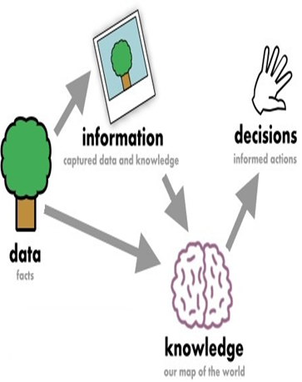
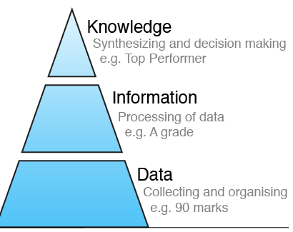
School of Computing Science and Engineering Course Code : MSCS1120 Course Name: DBMS
School of Computing Science & Engineering
Data, Information and Knowledge
Figure 4: Example of Data, Information and Knowledge
Program Name: MCA
Program Name: M.Sc. Program Code: MSCS1120

Slide 20
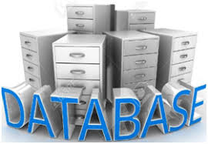

School of Computing Science and Engineering Course Code : MSCS1120 Course Name: DBMS
School of Computing Science & Engineering
Database
A repository of logically related and similar data.
An organized collection of related information so that it can easily be accessed, managed and updated.
It is supposed to meet the requirements of different users of an organization.
A self describing collection of integrated records.
Example includes Dictionary, Airline Database, Student Database, Library, Railways Timetable, YouTube (All songs of Mohd. Rafi, Jagjeet Singh)
Figure 5: Example of Database
Program Name: MCA
Program Name: M.Sc. Program Code: MSCS1120

Slide 21
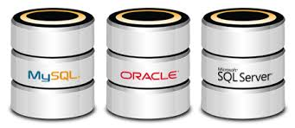
School of Computing Science and Engineering Course Code : MSCS1120 Course Name: DBMS
School of Computing Science & Engineering
Database Management System (DBMS)
A set of programs to access the interrelated data.
DBMS provides an interface to perform various operations like database creation, storing data in it, updating data, creating a table in the database.
It provides protection and security to the database. In the case of multiple users, it also maintains data consistency.
Example includes MySQL, Oracle, IBM’s DB2, Microsoft’s SQL Server, MS-Access etc are a very popular commercial database which is used in different applications.
Figure 6: Example of DBMS
Program Name: MCA
Program Name: M.Sc. Program Code: MSCS1120

Slide 22
School of Computing Science and Engineering Course Code : MSCS1120 Course Name: DBMS
School of Computing Science & Engineering
Characteristics of DBMS
Provides security and removes redundancy
Self-describing nature of a database system
Insulation between programs and data abstraction
Support of multiple views of the data
Sharing of data and multiuser transaction processing
DBMS allows entities and relations among them to form tables.
It follows the ACID concept (Atomicity, Consistency, Isolation, and Durability).
DBMS supports multi-user environment that allows users to access and manipulate data in parallel.
Program Name: MCA
Program Name: M.Sc. Program Code: MSCS1120

Slide 23
School of Computing Science and Engineering Course Code : MSCS1120 Course Name: DBMS
School of Computing Science & Engineering
Advantages of DBMS
Controlling Data Redundancy: Data is recorded in only one place in the database and it is not duplicated.
Data Consistency: Data item appears only once, and the updated value is immediately available to all users.
Control Over Concurrency: In a computer file-based system in updating, one may overwrite the values recorded by the other.
Backup and Recovery Procedures: automatically create the backup of data and restore data if required.
Data Independence: Separation of data structure of database from application program that uses the data is called data independence.
Program Name: MCA
Program Name: M.Sc. Program Code: MSCS1120

Slide 24
School of Computing Science and Engineering Course Code : MSCS1120 Course Name: DBMS
School of Computing Science & Engineering
Disadvantages of DBMS
Cost of Hardware and Software: Processor with high speed of data processing and memory of large size is required.
Cost of Data Conversion: Very difficult and costly method to convert data of data file into database.
Cost of Staff Training: A lot of amount for the training of staff to run the DBMS.
Appointing Technical Staff: Trained technical persons such as database administrator, application programmers, data entry operators etc. are required to handle the DBMS.
Database Damage: All data is integrated into a single database. If database is damaged due to electric failure or database is corrupted on the storage media, then your valuable data may be lost forever.
Program Name: MCA
Program Name: M.Sc. Program Code: MSCS1120

Slide 25
School of Computing Science and Engineering Course Code : MSCS1120 Course Name: DBMS
School of Computing Science & Engineering
File Processing System (FPS)
Earlier, computers are used for the scientific purpose.
Later, computers are used for the commercial applications.
In commercial application calculation or computation are not involved at a large scale. Only data processing (read data from different devices, store data after minor calculation output can be displayed on monitor or paper in a proper format).
Commercial applications introduced FPS.
FPS is a collection of programs that perform services.
File processing systems was an early attempt to computerize the manual filing system that we are all familiar with.
A file system is a method for storing and organizing computer files and the data they contain to make it easy to find and access them.
File systems may use a storage device such as a hard disk or CD-ROM and involve maintaining the physical location of the files.
Program Name: M. Sc.
Program Name: M.Sc. Program Code: M.Sc(CS)

Slide 26
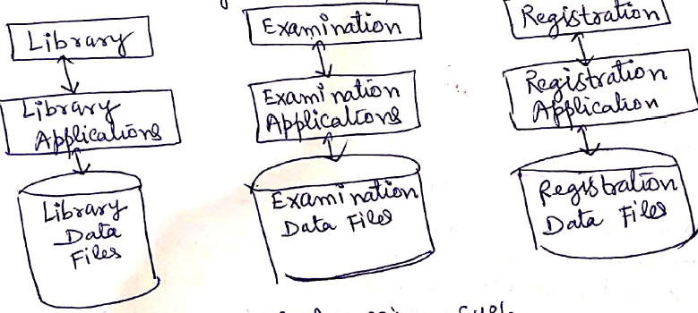
School of Computing Science and Engineering Course Code : MSCS1120 Course Name: DBMS
School of Computing Science & Engineering
File Processing System (FPS)
Consider a university system as depicted below.
Different system maintain their own database separately and they have their own program to process the data that is program and data independence
Figure 1: Traditional File Storage System of University Database
Program Name: MCA
Program Name: M.Sc. Program Code: M.Sc(CS)

Slide 27
School of Computing Science and Engineering Course Code : MSCS1120 Course Name: DBMS
School of Computing Science & Engineering
Characteristics of FPS
It is a group of files storing data of an organization.
Each file is independent from one another.
Each file is called a flat file.
Each file contained and processed information for one specific function, such as accounting or inventory.
Files are designed by using programs written in programming languages such as C, C++, etc.
The physical implementation and access procedures are written into database application; therefore, physical changes resulted in intensive rework on the part of the programmer.
As systems became more complex, file processing systems offered little flexibility, presented many limitations, and were difficult to maintain.
Program Name: MCA
Program Name: M.Sc. Program Code: M.Sc(CS)

Slide 28
School of Computing Science and Engineering Course Code : MSCS1120 Course Name: DBMS
School of Computing Science & Engineering
Limitations of FPS
Separated and Isolated Data: To make a decision, a user might need data from two separate files.
Duplication of data: Often the same information is stored in more than one file. It leads to loss of data integrity.
Data Dependence: Files and records were described by specific physical formats that were coded into the application program by programmers. If the format of a certain record was changed, the code in each file containing that format must be updated. Let us consider a student file, where information of students is stored in text file and each field is separated by blank space such as I Rama 22 India
Now, if the delimiter of the field changes from blank space to semicolon such as 1; Rama; 22; India
Then, the application programs using this file must be modified, because now it will token the field on semicolon; but earlier it was blank space.
Program Name: MCA
Program Name: M.Sc. Program Code: M.Sc(CS)

Slide 29
School of Computing Science and Engineering Course Code : MSCS1120 Course Name: DBMS
School of Computing Science & Engineering
Limitations of FPS
Difficulty in representing data from the user's view: To create useful applications for the user, often data from various files must be combined. In file processing it was difficult to determine relationships between isolated data in order to meet user requirements.
Data Inflexibility: Program-data interdependency and data isolation, limited the flexibility of file processing systems in providing users with ad-hoc information requests.
Data Security. The security of data is low in file based system because, the data is maintained in the flat file(s) is easily accessible.
Concurrency Problems
Program Name: MCA
Program Name: M.Sc. Program Code: M.Sc(CS)

Slide 30
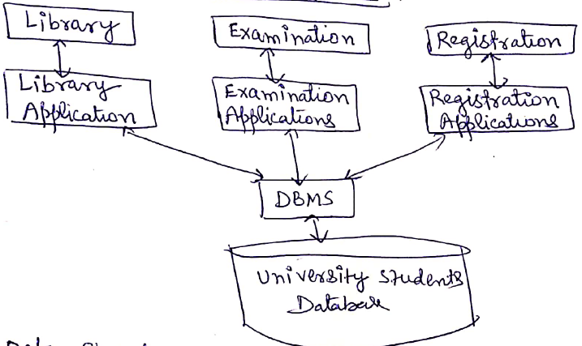
School of Computing Science and Engineering Course Code : MSCS1120 Course Name: DBMS
School of Computing Science & Engineering
FPS vs DBMS
Figure 2: FPS vs DBMS
Program Name: MCA
Program Name: M.Sc. Program Code: M.Sc(CS)

Slide 31
School of Computing Science and Engineering Course Code : MSCS1120 Course Name: DBMS
School of Computing Science & Engineering
FPS vs DBMS
DBMS | FPS
Multi-user access | It does not support multi-user access
Design to fulfill the need for small and large businesses | It is only limited to smaller DBMS system.
Remove redundancy and Integrity | Redundancy and Integrity issues
Expensive. But in the long term Total Cost of Ownership is cheap | It's cheaper
Easy to implement complicated transactions | No support for complicated transactions
Program Name: MCA
Program Name: M.Sc. Program Code: M.Sc(CS)

Slide 32
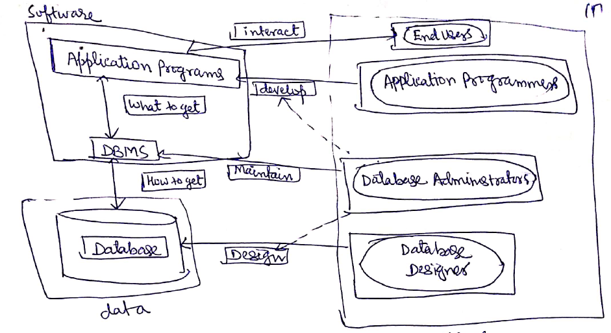
School of Computing Science and Engineering Course Code : MSCS1120 Course Name: DBMS
School of Computing Science & Engineering
Database System Environment
Figure 3: Database System Architecture
Program Name: MCA
Program Name: M.Sc. Program Code: M.Sc(CS)

Slide 33
School of Computing Science and Engineering Course Code : MSCS1120 Course Name: DBMS
School of Computing Science & Engineering
Users in Database System Environment
Application Programmers: The Application programmers write programs in various programming languages to interact with databases.
Database Administrators: Database Admin is responsible for managing the entire DBMS system. He/She is called Database admin or DBA.
End-Users: The end users are the people who interact with the database management system. They conduct various operations on database like retrieving, updating, deleting, etc.
Program Name: MCA
Program Name: M.Sc. Program Code: M.Sc(CS)

Slide 34
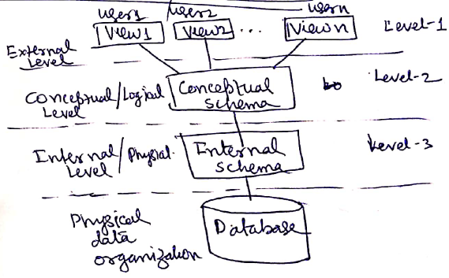
School of Computing Science and Engineering Course Code : MSCS1120 Course Name: DBMS
School of Computing Science & Engineering
Database Schema / Data Abstraction
A database schema is the skeleton structure that represents the logical view of the entire database.
It defines how the data is organized and how the relations among them are associated. It formulates all the constraints that are to be applied on the data.
It’s the database designers who design the schema to help programmers understand the database and make it useful.
Program Name: MCA
Program Name: M.Sc. Program Code: M.Sc(CS)

Slide 35
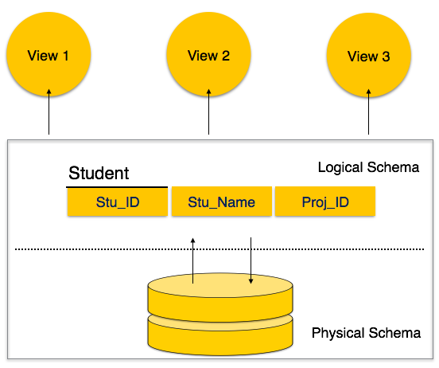
School of Computing Science and Engineering Course Code : MSCS1120 Course Name: DBMS
School of Computing Science & Engineering
Database Schema
Figure 3: Database Schema
Program Name: MCA
Program Name: M.Sc. Program Code: M.Sc(CS)

Slide 36
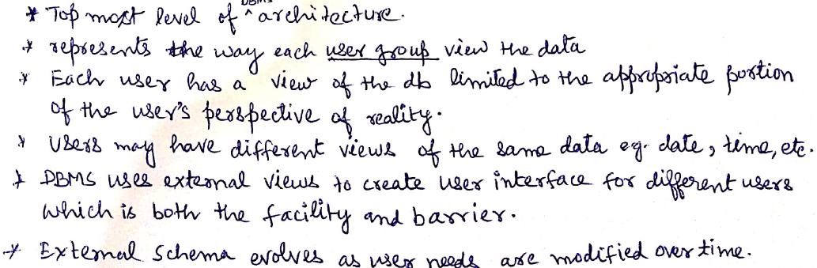
School of Computing Science and Engineering Course Code : MSCS1120 Course Name: DBMS
School of Computing Science & Engineering
External View (Level-1)
Program Name: MCA
Program Name: M.Sc. Program Code: M.Sc(CS)

Slide 37
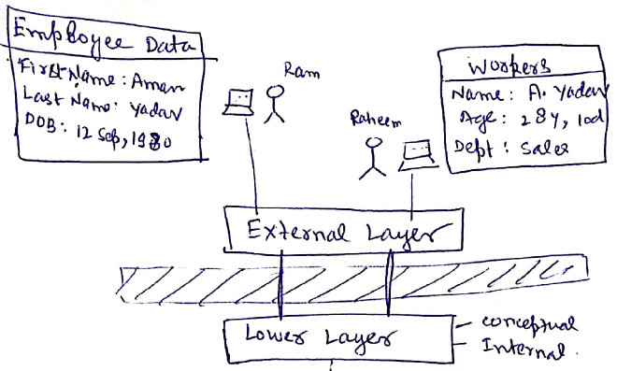
School of Computing Science and Engineering Course Code : MSCS1120 Course Name: DBMS
School of Computing Science & Engineering
External View (Level-1)
Figure 3: External View
Program Name: MCA
Program Name: M.Sc. Program Code: M.Sc(CS)

Slide 38
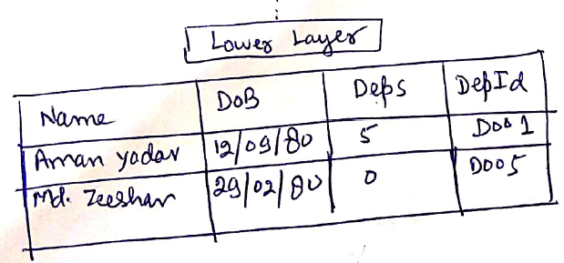
School of Computing Science and Engineering Course Code : MSCS1120 Course Name: DBMS
School of Computing Science & Engineering
Conceptual View/Logical Level (Level-2)
Describes structure of whole database, entities, their relationships and constraints.
Back
Figure 4: Conceptual View
Program Name: MCA
Program Name: M.Sc. Program Code: M.Sc(CS)

Slide 39
School of Computing Science and Engineering Course Code : MSCS1120 Course Name: DBMS
School of Computing Science & Engineering
Physical View/Internal Level (Level-3)
This level describes how the data is actually stored in the storage devices. This level is also responsible for allocating space to the data. This is the lowest level of the architecture.
It would also describe the data structures used by the database.
Program Name: MCA
Program Name: M.Sc. Program Code: M.Sc(CS)

Slide 40
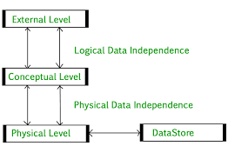
School of Computing Science and Engineering Course Code : MSCS1120 Course Name: DBMS
School of Computing Science & Engineering
Data Independence
Data independence refers characteristic of being able to modify the schema at one level of the database system without altering the schema at the next higher level.
There are two types of data independence: Logical Data Independence and Physical Data Independence
Figure 5: Data Independence
Program Name: MCA
Program Name: M.Sc. Program Code: M.Sc(CS)

Slide 41
School of Computing Science and Engineering Course Code : MSCS1120 Course Name: DBMS
School of Computing Science & Engineering
Logical Data Independence
Logical data independence refers characteristic of being able to change the conceptual schema without having to change the external schema.
Logical data independence is used to separate the external level from the conceptual view.
If we do any changes in the conceptual view of the data, then the user view of the data would not be affected.
Logical data independence occurs at the user interface level.
Program Name: MCA
Program Name: M.Sc. Program Code: M.Sc(CS)

Slide 42
School of Computing Science and Engineering Course Code : MSCS1120 Course Name: DBMS
School of Computing Science & Engineering
Physical Data Independence
Physical data independence can be defined as the capacity to change the internal schema without having to change the conceptual schema.
If we do any changes in the storage size of the database system server, then the Conceptual structure of the database will not be affected.
Physical data independence is used to separate conceptual levels from the internal levels.
Physical data independence occurs at the logical interface level.
Program Name: MCA
Program Name: M.Sc. Program Code: M.Sc(CS)

Slide 43
Data Models
School of Computing Science & Engineering
Data Model:
A set of concepts to describe the structure of a database, the operations for manipulating these structures, and certain constraints that the database should obey.
Data Model Structure and Constraints:
Constructs are used to define the database structure
Constructs typically include elements (and their data types) as well as groups of elements (e.g. entity, record, table), and relationships among such groups
Constraints specify some restrictions on valid data; these constraints must be enforced at all times
Program Name: MCA

Slide 44
Data Models (continued)
School of Computing Science & Engineering
Data Model Operations:
These operations are used for specifying database retrievals and updates by referring to the constructs of the data model.
Operations on the data model may include basic model operations (e.g. generic insert, delete, update) and user-defined operations (e.g. compute_student_gpa, update_inventory)
Program Name: MCA

Slide 45
Categories of Data Models
School of Computing Science & Engineering
Conceptual (high-level, semantic) data models:
Provide concepts that are close to the way many users perceive data.
(Also called entity-based or object-based data models.)
Physical (low-level, internal) data models:
Provide concepts that describe details of how data is stored in the computer. These are usually specified in an ad-hoc manner through DBMS design and administration manuals
Implementation (representational) data models:
Provide concepts that fall between the above two, used by many commercial DBMS implementations (e.g. relational data models used in many commercial systems).
Program Name: MCA

Slide 46
Schemas versus Instances
School of Computing Science & Engineering
Database Schema:
The description of a database.
Includes descriptions of the database structure, data types, and the constraints on the database.
Schema Diagram:
An illustrative display of (most aspects of) a database schema.
Schema Construct:
A component of the schema or an object within the schema, e.g., STUDENT, COURSE.
Program Name: MCA

Slide 47
Schemas versus Instances
School of Computing Science & Engineering
Database State:
The actual data stored in a database at a particular moment in time. This includes the collection of all the data in the database.
Also called database instance (or occurrence or snapshot).
The term instance is also applied to individual database components, e.g. record instance, table instance, entity instance
Program Name: MCA

Slide 48
Database Schema vs. Database State
School of Computing Science & Engineering
Database State:
Refers to the content of a database at a moment in time.
Initial Database State:
Refers to the database state when it is initially loaded into the system.
Valid State:
A state that satisfies the structure and constraints of the database.
Program Name: MCA

Slide 49
Database Schema vs. Database State (continued)
School of Computing Science & Engineering
Distinction
The database schema changes very infrequently.
The database state changes every time the database is updated.
Schema is also called intension.
State is also called extension.
Program Name: MCA

Slide 50
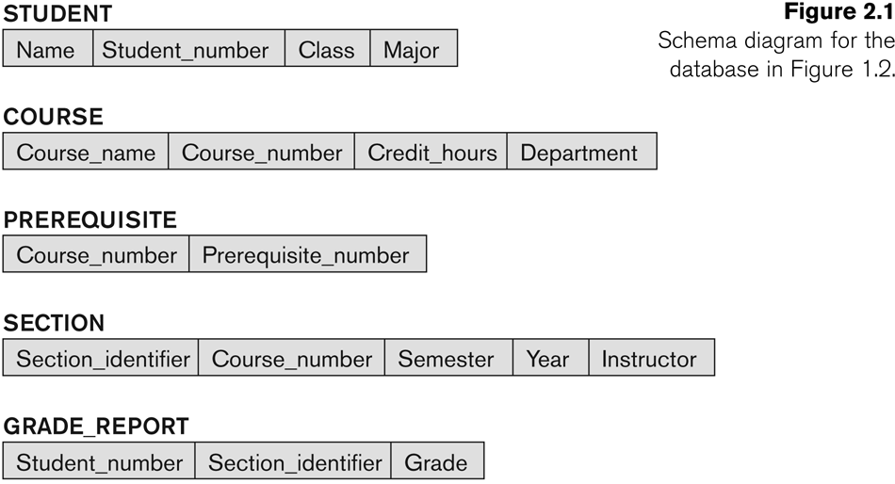
Example of a Database Schema
School of Computing Science & Engineering
Program Name: MCA

Slide 51
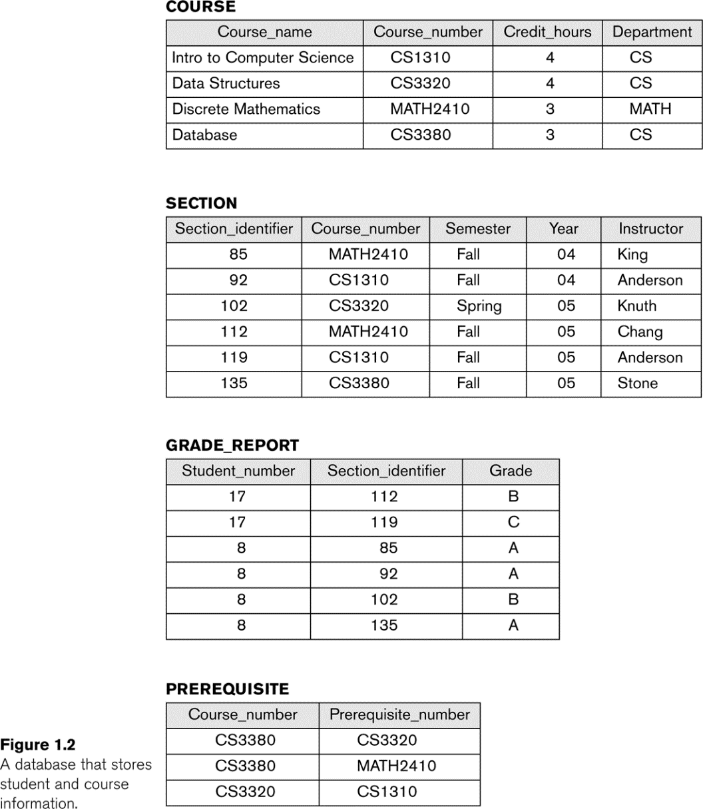
Example of a database state
School of Computing Science & Engineering
Program Name: MCA

Slide 52
Three-Schema Architecture
School of Computing Science & Engineering
Proposed to support DBMS characteristics of:
Program-data independence.
Support of multiple views of the data.
Not explicitly used in commercial DBMS products, but has been useful in explaining database system organization
Program Name: MCA

Slide 53
Three-Schema Architecture
School of Computing Science & Engineering
Defines DBMS schemas at three levels:
Internal schema at the internal level to describe physical storage structures and access paths (e.g indexes).
Typically uses a physical data model.
Conceptual schema at the conceptual level to describe the structure and constraints for the whole database for a community of users.
Uses a conceptual or an implementation data model.
External schemas at the external level to describe the various user views.
Usually uses the same data model as the conceptual schema.
Program Name: MCA

Slide 54
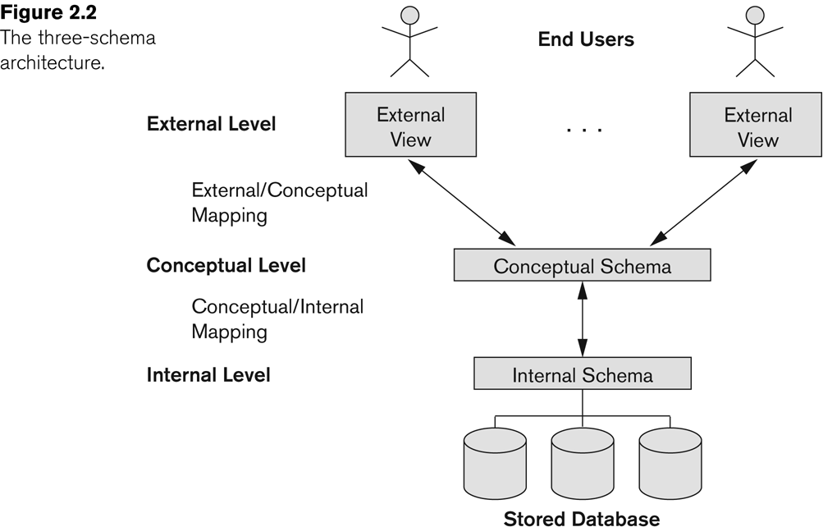
The three-schema architecture
School of Computing Science & Engineering
Program Name: MCA

Slide 55
Three-Schema Architecture
School of Computing Science & Engineering
Mappings among schema levels are needed to transform requests and data.
Programs refer to an external schema, and are mapped by the DBMS to the internal schema for execution.
Data extracted from the internal DBMS level is reformatted to match the user’s external view (e.g. formatting the results of an SQL query for display in a Web page)
Program Name: MCA

Slide 56
Data Independence
School of Computing Science & Engineering
Logical Data Independence:
The capacity to change the conceptual schema without having to change the external schemas and their associated application programs.
Physical Data Independence:
The capacity to change the internal schema without having to change the conceptual schema.
For example, the internal schema may be changed when certain file structures are reorganized or new indexes are created to improve database performance
Program Name: MCA

Slide 57
Data Independence (continued)
School of Computing Science & Engineering
When a schema at a lower level is changed, only the mappings between this schema and higher-level schemas need to be changed in a DBMS that fully supports data independence.
The higher-level schemas themselves are unchanged.
Hence, the application programs need not be changed since they refer to the external schemas.
Program Name: MCA

Slide 58
DBMS Languages
School of Computing Science & Engineering
Data Definition Language (DDL)
Data Manipulation Language (DML)
High-Level or Non-procedural Languages: These include the relational language SQL
May be used in a standalone way or may be embedded in a programming language
Low Level or Procedural Languages:
These must be embedded in a programming language
Program Name: MCA

Slide 59
DBMS Languages
School of Computing Science & Engineering
Data Definition Language (DDL):
Used by the DBA and database designers to specify the conceptual schema of a database.
In many DBMSs, the DDL is also used to define internal and external schemas (views).
In some DBMSs, separate storage definition language (SDL) and view definition language (VDL) are used to define internal and external schemas.
SDL is typically realized via DBMS commands provided to the DBA and database designers
Program Name: MCA.

Slide 60
DBMS Languages
School of Computing Science & Engineering
Data Manipulation Language (DML):
Used to specify database retrievals and updates
DML commands (data sublanguage) can be embedded in a general-purpose programming language (host language), such as COBOL, C, C++, or Java.
A library of functions can also be provided to access the DBMS from a programming language
Alternatively, stand-alone DML commands can be applied directly (called a query language).
Program Name: MCA

Slide 61
Types of DML
School of Computing Science & Engineering
High Level or Non-procedural Language:
For example, the SQL relational language
Are “set”-oriented and specify what data to retrieve rather than how to retrieve it.
Also called declarative languages.
Low Level or Procedural Language:
Retrieve data one record-at-a-time;
Constructs such as looping are needed to retrieve multiple records, along with positioning pointers.
Program Name: MCA

Slide 62
DBMS Interfaces
School of Computing Science & Engineering
Stand-alone query language interfaces
Example: Entering SQL queries at the DBMS interactive SQL interface (e.g. SQL*Plus in ORACLE)
Programmer interfaces for embedding DML in programming languages
User-friendly interfaces
Menu-based, forms-based, graphics-based, etc.
Program Name: MCA

Slide 63
DBMS Programming Language Interfaces
School of Computing Science & Engineering
Programmer interfaces for embedding DML in a programming languages:
Embedded Approach: e.g embedded SQL (for C, C++, etc.), SQLJ (for Java)
Procedure Call Approach: e.g. JDBC for Java, ODBC for other programming languages
Database Programming Language Approach: e.g. ORACLE has PL/SQL, a programming language based on SQL; language incorporates SQL and its data types as integral components
Program Name: MCA

Slide 64
User-Friendly DBMS Interfaces
School of Computing Science & Engineering
Menu-based, popular for browsing on the web
Forms-based, designed for naïve users
Graphics-based
(Point and Click, Drag and Drop, etc.)
Natural language: requests in written English
Combinations of the above:
For example, both menus and forms used extensively in Web database interfaces
Program Name: MCA

Slide 65
Other DBMS Interfaces
School of Computing Science & Engineering
Speech as Input and Output
Web Browser as an interface
Parametric interfaces, e.g., bank tellers using function keys.
Interfaces for the DBA:
Creating user accounts, granting authorizations
Setting system parameters
Changing schemas or access paths
Program Name: MCA

Slide 66
Database System Utilities
School of Computing Science & Engineering
To perform certain functions such as:
Loading data stored in files into a database. Includes data conversion tools.
Backing up the database periodically on tape.
Reorganizing database file structures.
Report generation utilities.
Performance monitoring utilities.
Other functions, such as sorting, user monitoring, data compression, etc.
Program Name: MCA

Slide 67
Other Tools
School of Computing Science & Engineering
Data dictionary / repository:
Used to store schema descriptions and other information such as design decisions, application program descriptions, user information, usage standards, etc.
Active data dictionary is accessed by DBMS software and users/DBA.
Passive data dictionary is accessed by users/DBA only.
Program Name: MCA

Slide 68
Other Tools
School of Computing Science & Engineering
Application Development Environments and CASE (computer-aided software engineering) tools:
Examples:
PowerBuilder (Sybase)
JBuilder (Borland)
JDeveloper 10G (Oracle)
Program Name: MCA

Slide 69
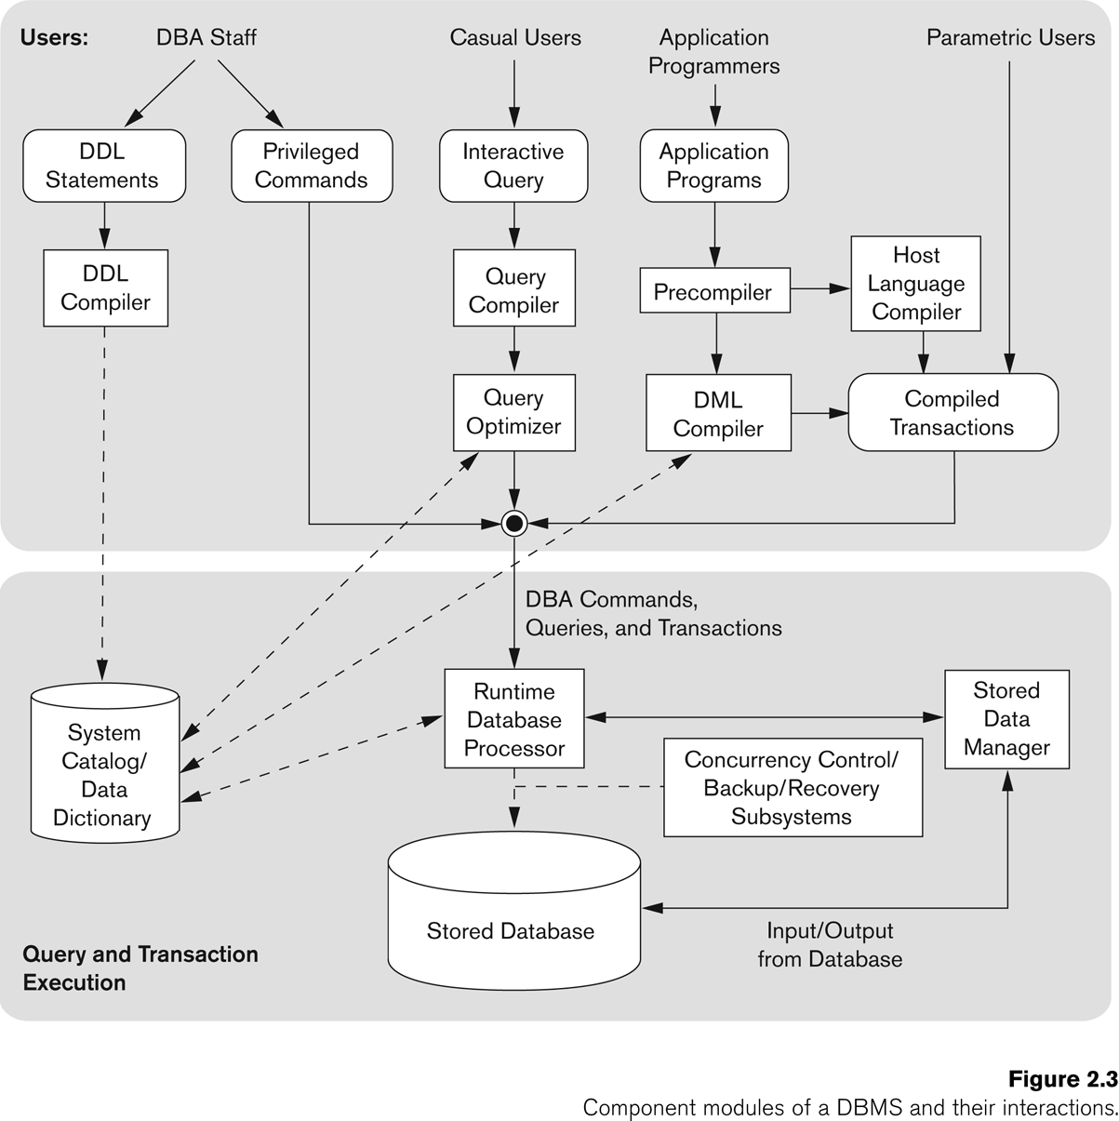
Typical DBMS Component Modules
School of Computing Science & Engineering
Program Name: MCA

Slide 70
Centralized and Client-Server DBMS Architectures
School of Computing Science & Engineering
Centralized DBMS:
Combines everything into single system including- DBMS software, hardware, application programs, and user interface processing software.
User can still connect through a remote terminal – however, all processing is done at centralized site.
Program Name: MCA

Slide 71
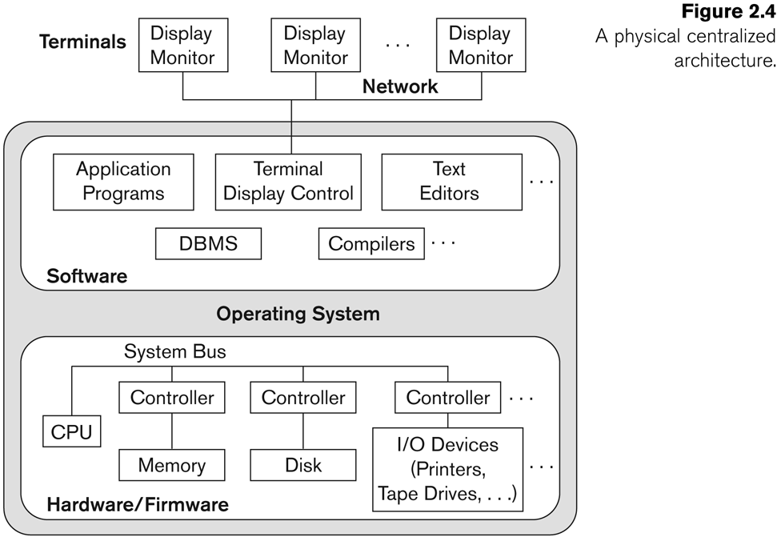
A Physical Centralized Architecture
School of Computing Science & Engineering
Program Name: MCA

Slide 72
Basic 2-tier Client-Server Architectures
School of Computing Science & Engineering
Specialized Servers with Specialized functions
Print server
File server
DBMS server
Web server
Email server
Clients can access the specialized servers as needed
Program Name: MCA

Slide 73
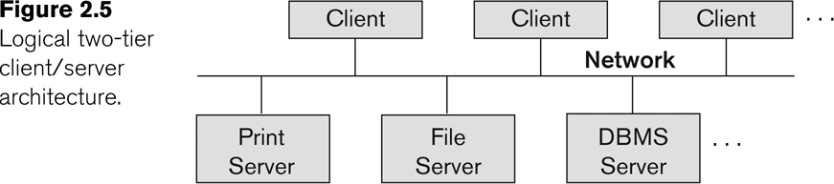
Logical two-tier client server architecture
School of Computing Science & Engineering
Program Name: MCA

Slide 74
Clients
School of Computing Science & Engineering
Provide appropriate interfaces through a client software module to access and utilize the various server resources.
Clients may be diskless machines or PCs or Workstations with disks with only the client software installed.
Connected to the servers via some form of a network.
(LAN: local area network, wireless network, etc.)
Program Name: MCA

Slide 75
DBMS Server
School of Computing Science & Engineering
Provides database query and transaction services to the clients
Relational DBMS servers are often called SQL servers, query servers, or transaction servers
Applications running on clients utilize an Application Program Interface (API) to access server databases via standard interface such as:
ODBC: Open Database Connectivity standard
JDBC: for Java programming access
Client and server must install appropriate client module and server module software for ODBC or JDBC
See Chapter 9
Program Name: MCA

Slide 76
Two Tier Client-Server Architecture
School of Computing Science & Engineering
A client program may connect to several DBMSs, sometimes called the data sources.
In general, data sources can be files or other non-DBMS software that manages data.
Other variations of clients are possible: e.g., in some object DBMSs, more functionality is transferred to clients including data dictionary functions, optimization and recovery across multiple servers, etc.
Program Name: MCA

Slide 77
School of Computing Science & Engineering
References:
Abraham Silberschatz, Henry F. Korth and S. Sudarshan- “Database System Concepts”, Fourth Edition, McGraw-Hill, 2002.
Ramez Elmasri and Shamkant B. Navathe, “Fundamental Database Systems”, Third Edition, Pearson Education, 2003.
Raghu Ramakrishnan, “Database Management System”, Tata McGraw- Hill Publishing Company, 2003.
www.slideshare.net
Coursera - https://www.coursera.org/learn/database-management
NPTEL- https://nptel.ac.in/courses/106/105/106105175/
https://www.coursera.org/learn/research-methods
https://www.coursera.org/browse/physical-science-and-engineering/research-methods
Program Name: MCA

